Slide 2

Giving your Apps the Fluent UI Look and Feel with Delphi Part Two
Presented by Ian Barker about.me/IanBarker www.codedotshow.com/blog

Slide 3
Did you miss part one?
My blog post about part one is here https://tinyurl.com/delphifluentui
My blog post about THIS webinar is here https://tinyurl.com/delphifluentui2
You can reach me here https://about.me/IanBarker
All the code is in my github repo here: https://github.com/checkdigits/fancy_ui

Slide 4
A quick recap.. Why Fluent UI?
It is the latest iteration of Microsoft’s “design language” adopted by the latest versions of Windows 10 and Microsoft apps
Official site is here: https://www.microsoft.com/design/fluent/
Also described less well here: https://en.wikipedia.org/wiki/Fluent_Design_System

Slide 5
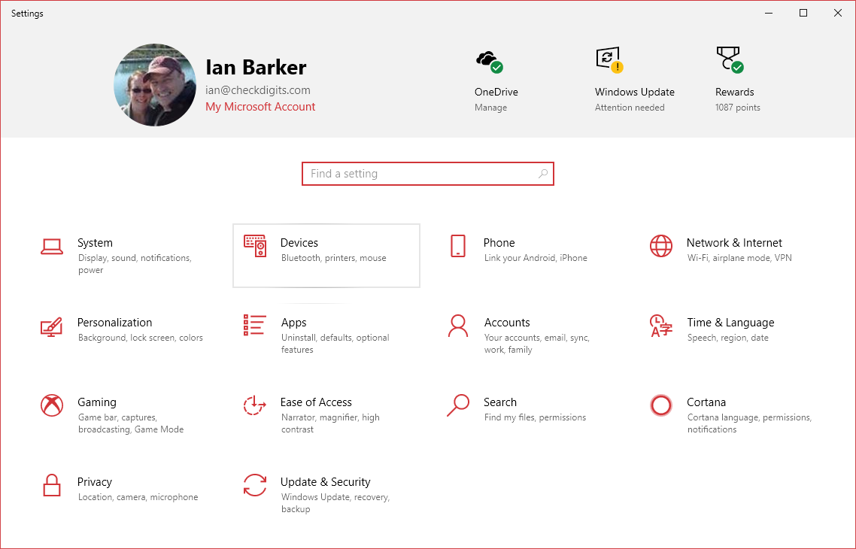
Fluent UI in action – Windows 10 settings screen

Slide 6
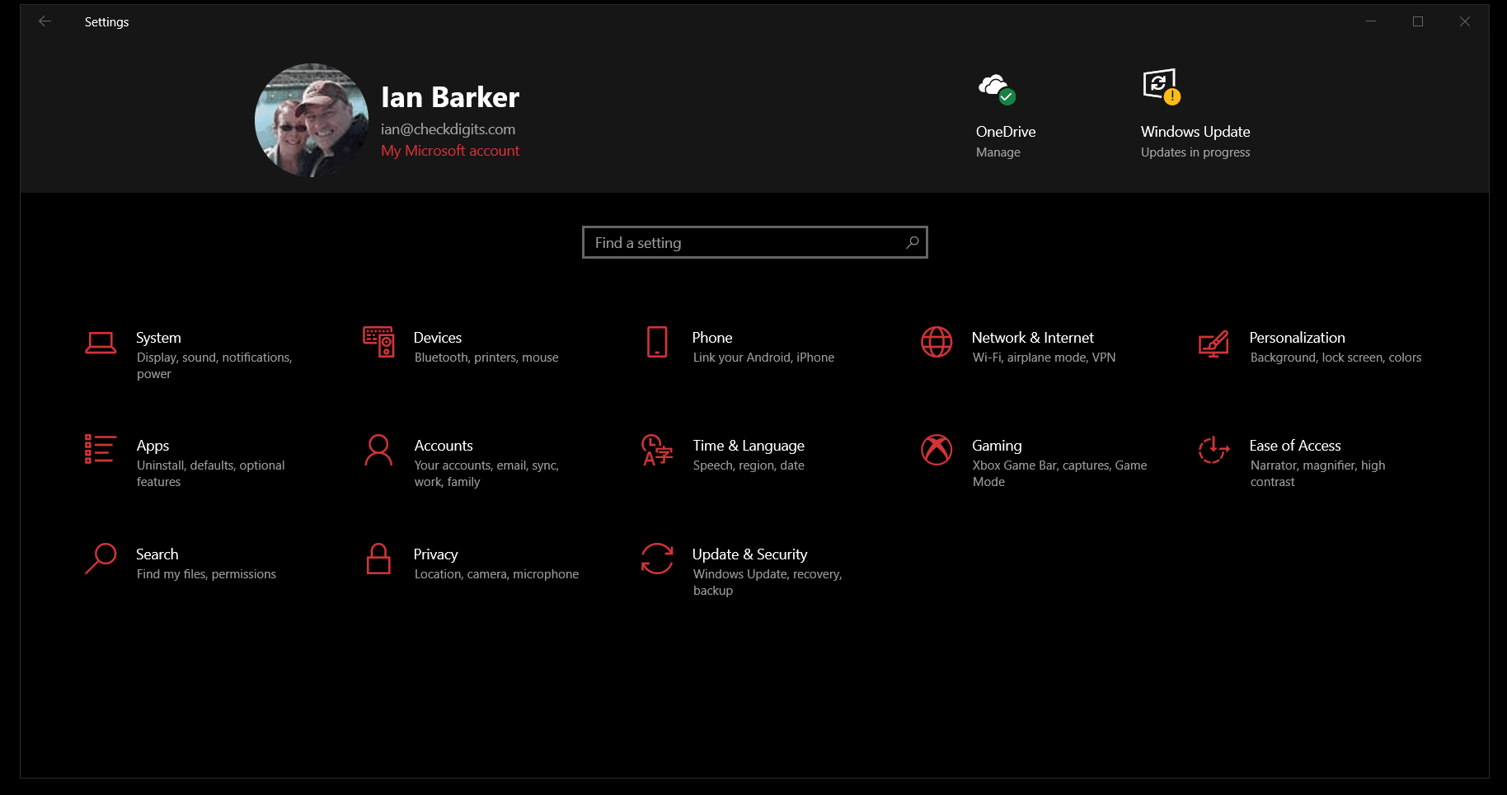
Fluent UI in action – also available, The Dark Side

Slide 7
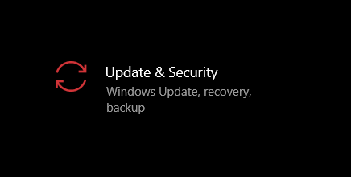
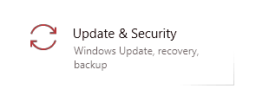
Key concepts… Light
Reveal highlight
Reveal focus

Slide 8
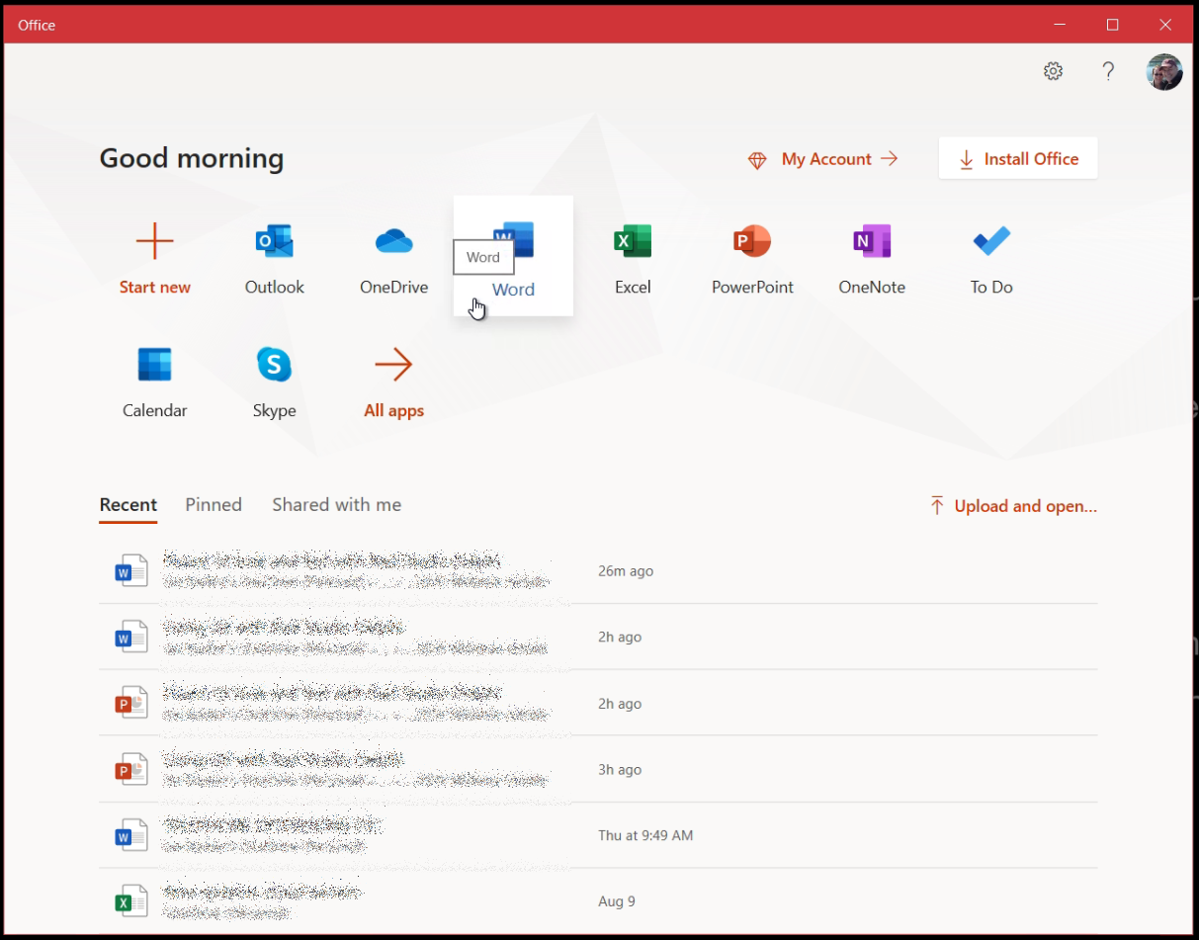
Key concepts… Depth
Along the Z axis for “content differentiation via layering”
Shadows are back!
Most noticeable in the Office 2019 App
Makes controls offer ‘affordance’ by becoming three dimensional or ‘phat flat’

Slide 9
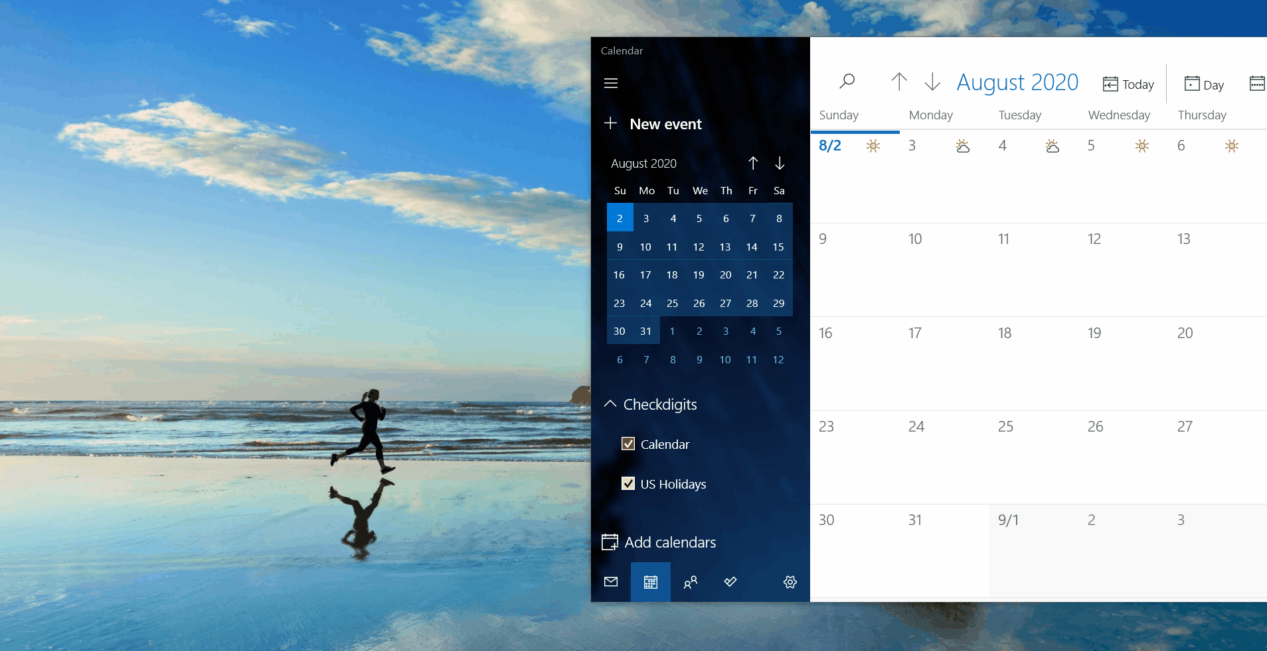
Key concepts… Motion
Windows 10 Mail App sign up screen shows this best!
Watch the clouds
Notes:
- Add/delete animations
- Connected animations
- Content transition
- Drill down
- Fade in/out
- Parallax - currently more visible on web pages but also applies to background images on windows with scrolling content
- Feedback on presses – “affordance”, did my click work?

Slide 10
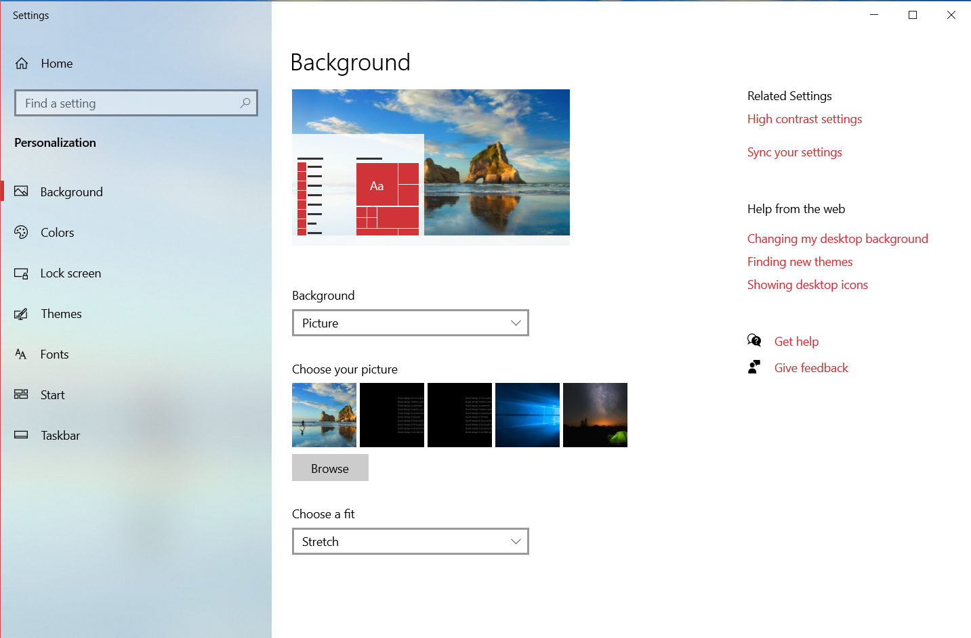
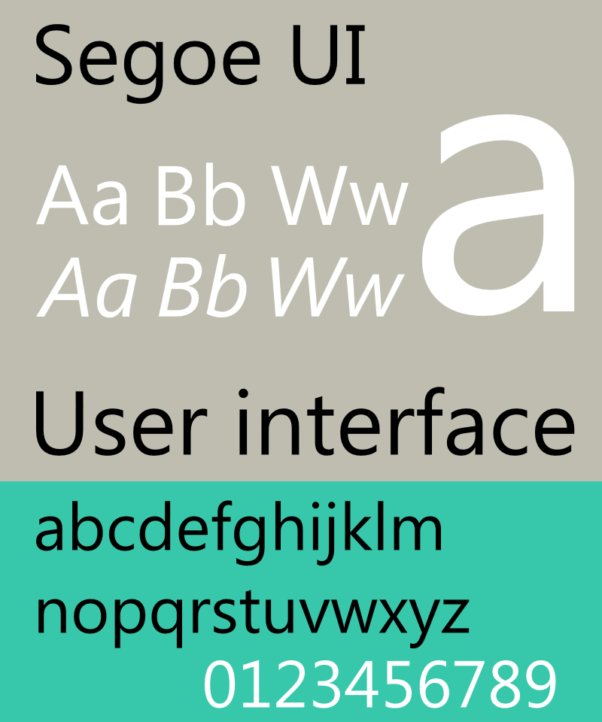
Key concepts… Fonts and icons
Segoe UI font everywhere
Notes:
SEE GO - Icons are the most noticeable part of the whole thing – and the Microsoft product managers are clearly still playing a tug of war with the UI and UX designers because they just redesigned virtually all the desktop icons for Microsoft’s apps 😊

Slide 11
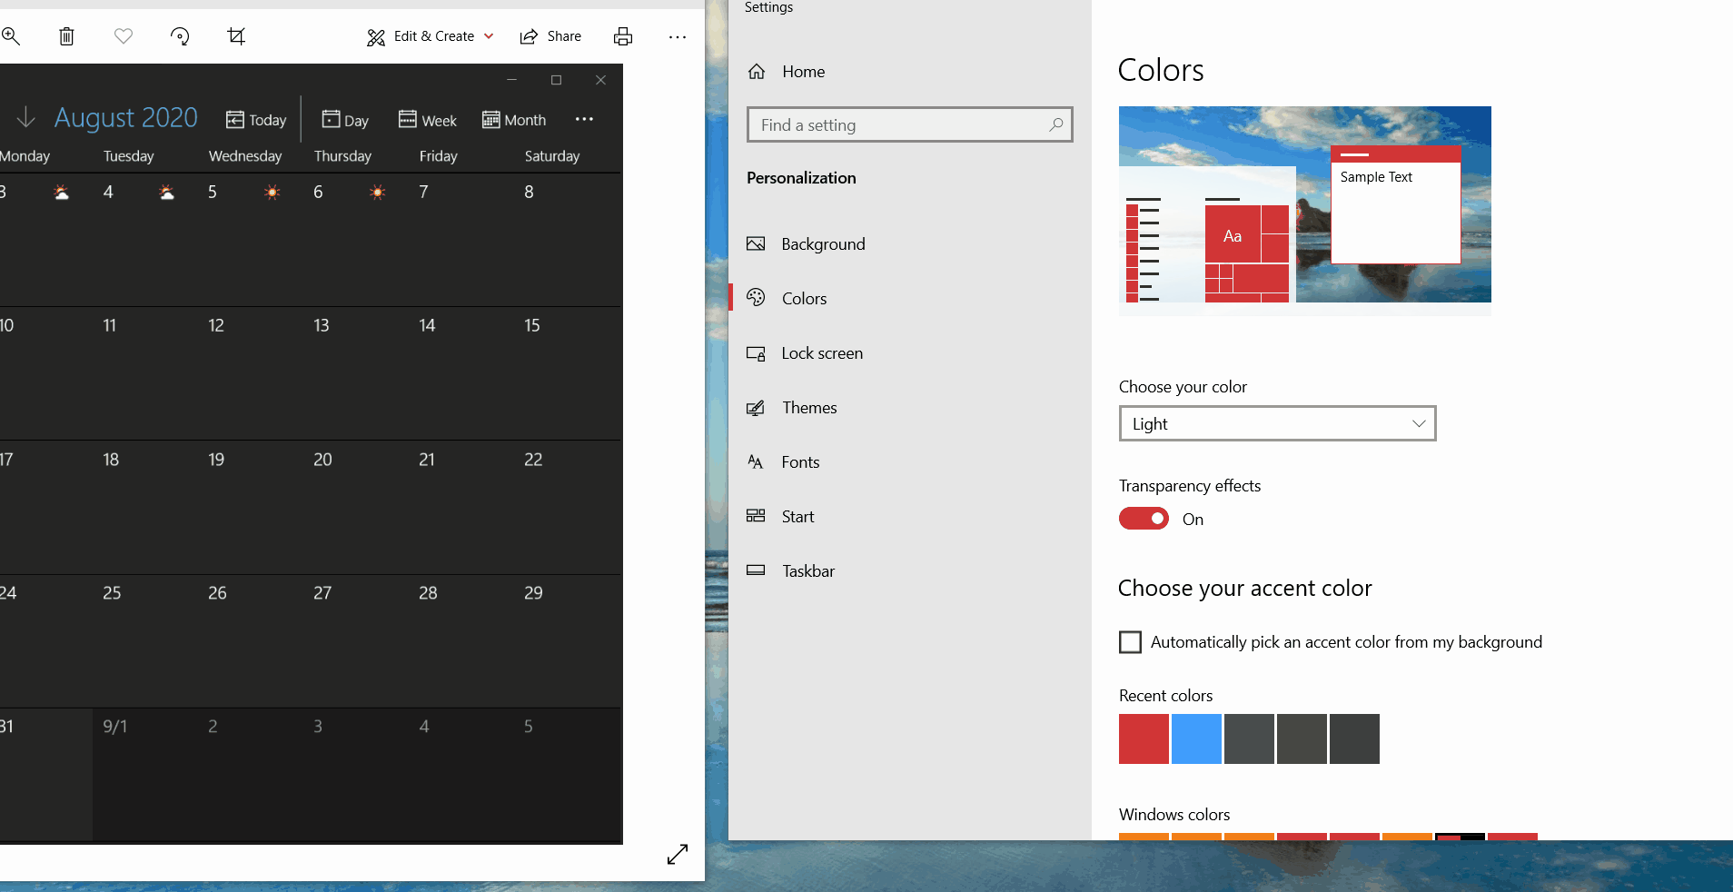
Key concepts… Material
‘Acrylic’
Dynamic blurring
Alpha layers and transparency

Slide 12
Let’s take a look!
Demo time

Slide 13
Good resources
Microsoft Official Fluent UI site
https://developer.microsoft.com/en-us/fluentui#/
Segoe UI
https://en.wikipedia.org/wiki/Segoe
Interesting blog post
https://medium.com/microsoft-design/how-fluent-ui-unlocks-the-next-generation-of-microsoft-365-experiences-8b24809faf06
Almedia Dev Style Controls
http://www.almdev.com

Slide 14
Q & A
Presented by Ian Barker about.me/IanBarker www.codedotshow.com/blog

Slide 15
Presented by Ian Barker about.me/IanBarker www.codedotshow.com/blog

